Slide 1
CIS 449/549: Software Security
Anys Bacha
Slides from U. Shankar, M. Hicks, K. Du, D. Boneh, N. Zeldovich, A. Rahmati

Slide 2
What is a Buffer Overflow?
The Bugs Framework (government entity that classifies bugs into distinct classes) defines a buffer overflow as
software accesses through an array of memory that is outside the boundary of the array

Slide 3
What is a Buffer Overflow?
Buffer overflows (BOF) stem primarily from low level bugs written in C/C++
In most cases buffer overflows cause crashes, but if maliciously crafted can result in:
Private data being stolen
Arbitrary code being executed
Critical information being corrupted
Notes:
Java uses JVM interpreter and Python uses a C-based interpreter for example; more overhead.

Slide 4
How Relevant Are BOF
Performance is always at the top of the feature list
We like technology to always be fast
Low level languages such as C/C++ are still very popular
Systems software often written in C/C++ (operating systems, file systems, databases, compilers, network servers, command shells, etc.)

Slide 5
How Relevant Are BOF
Many big companies still rely on C++ for their software including Google and Facebook (driven by performance)
Internet of Things (IoT) software is primarily developed in C due to the limited hardware resources
Compromises can result in significant damage
Arbitrary code execution

Slide 6
How Relevant Are BOF
Low level languages has the downside of exposing memory details
Exposes raw pointers to memory
Does not explicitly perform bounds-checking on arrays
Hardware doesn’t check this
We want to be as close to the hardware as possible
Notes:
The only place (such as on Intel processors that use technology called VTX) where hardware checks memory is through virtualization (hardware built to allow translating memory addresses to another location –aka another guest – so that multiple hosts (virtual machines) can run on same hardware; but also 2 access to memory happen every single memory access, that is why virtual machines have much slower performance.
Besides virtualization, hardware does not check memory

Slide 7
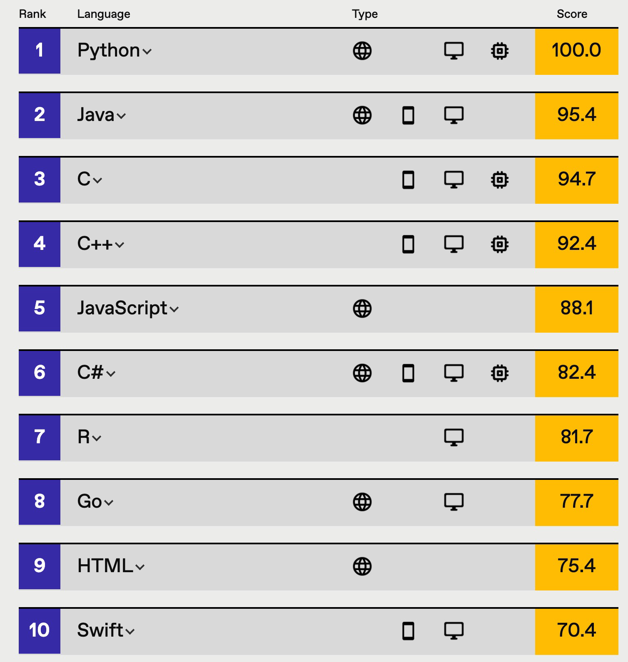

C/C++ Still Popular
Notes:
Crazy note: numpy Python library is written in FORTRAN.

Slide 8
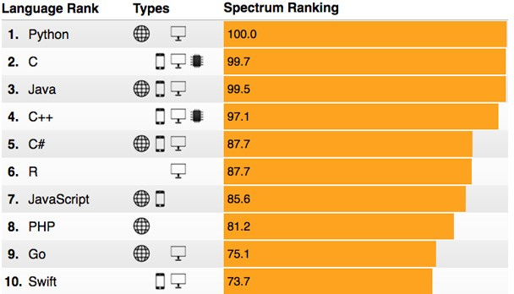
C/C++ Still Popular
https://spectrum.ieee.org/computing/software/the-2017-top-programming-languages

Slide 9
Memory Layout
Notes:
This review is based on x86 32-bit machine memory layout

Slide 10
Program Layout in Memory
4G 0xFFFFFFFF
Process thinks it owns the entire range
Virtual addresses that the OS maps to physical memory addresses
0
0x00000000
Notes:
This review is based on x86 32-bit machine memory layout
2^32bits = 4GB of RAM
Note that I/O buffers share this RAM memory space
After a process goes tries to access its (virtual) memory address, the address goes through TLB (Translation Lookup Block), if the page is not in memory, then page needs to be retrieved from disk and loaded to memory.

Slide 11
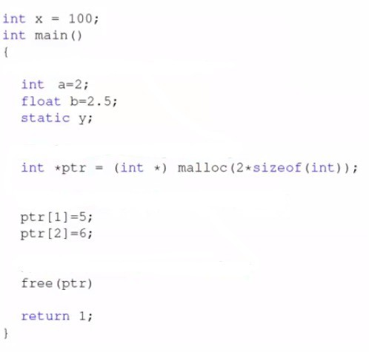
Program Layout in Memory
4G
cmdline & env
Stack
Heap
BSS Segment
Data Segment
Text
Where would variables be located?
0
Notes:
ABOVE SEGMENTS SET UP BY OS AND SENT OFF TO THE PROCESS

Slide 12
Program Layout in Memory
4G
cmdline & env
Stack
Heap
BSS Segment
Data Segment
Text
Where would variables be located?
0
Notes:
x is a global variable → it would be in DATA SEGMENT

Slide 13
Program Layout in Memory
4G
cmdline & env
Stack
Heap
BSS Segment
Data Segment
Text
Where would variables be located?
0
Notes:
a and b (local variables) are in STACK

Slide 14
Program Layout in Memory
4G
cmdline & env
Stack
Heap
BSS Segment
Data Segment
Text
Where would variables be located?
0
Notes:
Uninitialized y is a static variable → in BSS SEGMENT
BSS = Boot Strap Segment (note terminology has nothing to do with bootstrapping)
Static variables are initialized only once
They are not destroyed when the function is over, that is why they are STATIC
As long as process that a function belongs to is alive, every time that function is called, static variables are not destroyed or reinitialized.
All functions a part of the process static variable was declared can access the static variable at any time, since they are never destroyed and retain their value as for duration of the process that it was declared a part of.
Uninitialized static and global variables go into the BSS segment and are initialized by OS to 0.
Otherwise, initialized static and global variables go to the DATA segment.

Slide 15
Program Layout in Memory
4G
cmdline & env
Stack
Heap
BSS Segment
Data Segment
Text
Where would variables be located?
0
Notes:
Pointer variable ptr is in STACK segment;
The memory allocated to which ptr points is in the HEAP segment

Slide 16
Program Layout in Memory
4G 0xFFFFFFFF
When process starts
cmdline & env
Stack
Heap
BSS Segment
Data Segment
Text
int foo(){
int x;
…
Local variables
Runtime
malloc(sizeof(long));
static int x;
Static and global
Known at compile time
static int y = 10; ^{variables}
0
0x00000000
Notes:
TEXT SEGMENT = MACHINE CODE INSTRUCTIONS (associated with the text (i.e. c or c++) code so that the process will point to text segment in order to execute and move to next instructions.

Slide 17
Focus on Stack-based Attacks
4G 0xFFFFFFFF
Stack
Heap
The stack is adjusted through instructions generated by the compiler provides
Stack and heap grow in opposite directions
0
0x00000000

Slide 18
Focus on Stack-based Attacks
The stack is adjusted through instructions generated by the compiler provides
0x00000000
0xFFFFFFFF
 | Heap |  | Stack
Stack pointer
push 1
push 2
push 3
Notes:
Stack pointer = a register holding memory address that points to stack

Slide 19
Focus on Stack-based Attacks
The stack is adjusted through instructions generated by the compiler provides
0x00000000
0xFFFFFFFF
 | Heap |  | 3 | 2 | 1 | Stack
The heap is allocated by the OS and managed by the process through malloc()
Stack pointer
push 1
push 2
push 3
Notes:
NOTE: new and delete in c++ is just using malloc and free()

Slide 20
Function Calls
int main() {
…
foo(1, 2, 3);
…
}
void foo(int arg1, int arg2, int arg3) { char loc1[4];
int loc2;
…
}
Caller:
Push arguments onto stack in reverse order
Push return address
%eip + sizeof( curr inst.)
Branch to function address
Restore stack by popping arguments
Callee:
Push old frame pointer (%ebp)
Set %ebp to top of stack (where old %ebp
stored)
Push local variables
…
Restore old stack frame
%esp = %ebp; pop %ebp
Branch to return address: pop %eip
Notes:
Stack needs to be prepared for foo() call, so main function needs to
1) push arguments onto stack in reverse order.
2) push return address onto stack so foo() knows the address that needs to be pointed to when it returns
eip register = extended instruction pointer register. Points to next instruction to be executed.
Remember: we are using Intel x86 32-bit architecture, which is a CISC architecture (Complex instruction set computer architecture; instructions are not the same size). So it is important to do sizeof(curr inst.)
CISC allows you to combine instructions complexly and have less lines of code.
Problem: FDE process (fetch decode execute) takes a long time to decode since instructions are different sizes; takes more time for decoder; execution time takes longer primarily because of decode time.
RISC (Reduced instruction set computer) has all same size instructions; faster decode time (i.e. ARM is RISC architecture).
NOW, we branch to text segment where foo is, then the CALLEE NEEDS TO:
1) push old frame pointer (pointer to stack frame associated with the CALLER) via ebp register
2) then set ebp (base pointer) to point to top of stack of the foo (callee) stack frame
3) push local variables
4) execute other code
5) restore old stack frame
6) return back to CALLER stack frame and text section by restoring esp and ebp to be values that Caller contained before calling foo()

Slide 21
Function Calls
0x00000000
0xFFFFFFFF
Stack frame of callee
 | Heap |  |  | loc2 | loc1 | %ebp | %eip | arg1 | arg2 | arg3 | Caller’s data
New
%ebp
%ebp
Notes:
%ebp is doing 2 things at once
Take caller ebp value and push onto stack
Then update ebp to point to the stack frame location where the copied ebp value was pushed

Slide 22
Summary of Function Calls
Calling function:
Push arguments onto the stack in reverse order
Push the return address of the next instruction to be run in the calling function
%eip + sizeof(current instruction) → next instruction to be executed when we return to the calling function
Branch to the function’s address
Called function:
Push the old frame pointer onto the stack (%ebp)
Set the new frame pointer %ebp to where the old %ebp was pushed
Push local variables onto the stack

Slide 23
Summary of Function Calls
Returning to calling function:
Reset the previous stack frame
%ebp = (%ebp)
Need to copy %ebp into another register first
Jump back to the return address
%eip = 4(%ebp) (assuming next instruction is 4 bytes long)
Need to use copied value of ebp (current stack frame)
Notes:
%eip = 4(%ebp) (means eip = ebp + 4)

Slide 24
Stack Layout Example
Stack Frame
void foo(int a, int b) { int x, y;
x = a+b; y = a – b;
}
foo(5, 6);
 |  |  |  |  |  |  | Caller’s data
What does the stack frame look like?

Slide 25
Stack Layout Example
Stack Frame
void foo(int a, int b) { int x, y;
foo(5, 6);
x = a+b; y = a – b;
How do we reference a, b, x, y?
}
 | y | x | %ebp | %eip | a=5 | b=6 | Caller’s data
Binary code is generated during compilation stage!

Slide 26
Stack Layout Example
Stack Frame
void foo(int a, int b) { int x, y;
Frame Pointer
foo(5, 6);
movl 12(%ebp), %eax movl 8(%ebp), %edx addl %edx, %eax movl %eax, -4(%ebp)
x = a+b; y = a – b;
How do we reference a, b, x, y?
}
 | y | x | %ebp | %eip | a=5 | b=6 | Caller’s data
Binary code is generated during compilation stage!
Compiler uses offsets relative to ebp
Notes:
movl 12(%ebp), %eax
Move b (6) into eax register
movl 8(%ebp), %edx
Move a (5) into edx register
addl %edx, %eax
Add edx and eax register contents, store in eax → 11
movl %eax, -4(%ebp)
Move eax register contents into x (assign x = 11).

Slide 27
Copying Data to a Buffer
int main() {
…
char src[40] = “Hello world \0 Extra string”; char dest[40];
strcpy(dest, src); return 0;
}
A buffer overflow involves copying data to a buffer
Notes:
Remember strcpy default delimiter is null char \0

Slide 28
Copying Data to a Buffer
int main() {
…
char src[40] = “Hello world \0 Extra string”; char dest[40];
What is this?
strcpy(dest, src);
return 0;
}
A buffer overflow involves copying data to a buffer
Notes:
Remember strcpy default delimiter is null char \0

Slide 29
Copying Data to a Buffer
int main() {
…
char src[40] = “Hello world \0 Extra string”; char dest[40];
What is this?
strcpy(dest, src);
Tells compiler to insert 0x0 in binary
return 0;
}
A buffer overflow involves copying data to a buffer
Notes:
When you do \##, it puts that actual hexadecimal number in the memory location.

Slide 30
Copying Data to a Buffer
Different ways to copy data
int main() {
…
char src[40] = “Hello world \0 Extra string”; char dest[40];
strcpy()
How does strcpy do the copy?
memcpy()
Needs size
What is this?
strcpy(dest, src);
Tells compiler to insert 0x0 in binary
return 0;
}
A buffer overflow involves copying data to a buffer
Notes:
Remember strcpy default delimiter is null char \0

Slide 31
Buffer Overflow
void foo (char *str) { char buffer[12];
}
int main() {
char *str = “This is definitely longer than 12”; foo(str);
return 0;
}
strcpy(buffer, str);
What will happen after this?
 | buffer[0]…buffer[11] | %ebp | %eip | str | Caller’s data
Buffer copy

Slide 32
Buffer Overflow
void foo (char *str) { char buffer[12];
}
int main() {
char *str = “This is definitely longer than 12”; foo(str);
return 0;
}
Execute unmapped address
strcpy(buffer, str);
Jump to protected place
Invalid instruction
 | buffer[0]…buffer[11] | %ebp | %eip | str | Caller’s data
Buffer copy
Notes:
Possibly could crash; but also, the return address stored in eip that was overwritten by bof, will still be treated as an address (whatever value that eip holds, processor simply jumps to that address whether it is valid or not (not valid referring to protected memory space, etc.)).
Most memory stores raw data, so unlikely eip will be overwritten with a valid/useful address.

Slide 33
Buffer Overflow Example 1
void foo (char *arg1) { char buffer[4]; strcpy(buffer, arg1);
…
}
int main() {
char *str = “AuthMe!”; foo(str);
…
}
What will this code do?
Describe the stack layout after foo() is called?
? | Caller’s data

Slide 34
Buffer Overflow Example 1
void foo (char *arg1) { char buffer[4]; strcpy(buffer, arg1);
…
}
int main() {
char *str = “AuthMe!”; foo(str);
…
}
What will happen to the program?
M e ! \0
 | A u t h | 4d 65 21 00 | %eip | arg1 | Caller’s data
buffer
Notes:
so %ebp was overwritten with a new address from being overflowed with contents of str (showing the ascii equivalent of ‘Me!\0’.
foo() function will run just fine
But when you return to MAIN function, then %ebp location will be updated to point to the contents it was storing (which has been overwritten with bad data), and thus MAIN’s base pointer that was saved in %ebp during foo() execution is corrupted; then MAIN will not be able to properly access its variables since the base pointer is at the wrong location (you will get seg fault or pull in garbage data relative to corrupted ebp pointer when trying to access local variables).

Slide 35
Buffer Overflow Example 1
void foo (char *arg1) { char buffer[4]; strcpy(buffer, arg1);
…
}
int main() {
char *str = “AuthMe!”; foo(str);
…
}
What will happen to the program?
Crash with SEGFAULT due to bad %ebp
M e ! \0
 | A u t h | 4d 65 21 00 | %eip | arg1 | Caller’s data
buffer
Notes:
Remember: every variable (and registers) have an address and data stored at that address.

Slide 36
Buffer Overflow Example 2
void foo (char *arg1) { int authenticated = 0; char buffer[4]; strcpy(buffer, arg1); if(authenticated) {…}
}
int main() {
char *str = “AuthMe!”; foo(str);
return 0;
}
What will this code do?
Describe the stack layout after foo() is called?
? | Caller’s data

Slide 37
Buffer Overflow Example 2
void foo (char *arg1) { int authenticated = 0; char buffer[4]; strcpy(buffer, arg1); if(authenticated) {…}
}
int main() {
char *str = “AuthMe!”; foo(str);
return 0;
}
The user is now authenticated without any crashes
M e ! \0
 | A u t h | 4d 65 21 00 | %ebp | %eip | arg1 | Caller’s data
buffer
authenticated
Notes:
Thus if() statement will evaluate to TRUE since a non 0 value is inside of authenticated variable.

Slide 38
Most Programs Process User Input
Previous examples used hardcoded strings
Most useful programs require some level of interaction with the user
Users can supply input through a multitude of mechanisms including text input, packets over the networks, environment variables, and file input

Slide 39
What Can We Do with User Input?
void foo (char *arg1) { char buffer[4]; strcpy(buffer, arg1);
…
}
What can we do with user input to make this more interesting?
 | 00 00 00 00 | %ebp | %eip | arg1 | Caller’s data
buffer

Slide 40
What Can We Do with User Input?
void foo (char *arg1) { char buffer[4]; strcpy(buffer, arg1);
…
}
What can we do with user input to make this more interesting?
 | 00 00 00 00 | %ebp | %eip | arg1 | Caller’s data
buffer
strcpy() allows you to overwrite memory until \0 is encountered
What can you do with this knowledge?

Slide 41
Code Injection

Slide 42
Overview
Goal:
void foo (char *arg1) { char buffer[4]; sprintf(buffer, arg1);
…
}
Use input as attack surface
Insert user supplied code into memory
Set %eip to point to user code
 | Text |  | 00 00 00 00 | %ebp | %eip | arg1 | Malicious code
buffer
%eip
We must overcome a few challenges to make this work
Notes:
Best thing an attacker can do: get a shell (root) access.

Slide 43
Challenge 1
Must directly load machine code into memory (instructions we want to see executed) (i.e. ‘\ x04\x3d\x01\x0f’)
The machine code must not contain any zeros
Zeros would cause sprintf(), gets(), scanf(), strcpy() to stop copying
So, entire binary malicious code injection packet cannot contain any \0’s
Need to run a general purpose shell that provides attacker with easy access to system resources

Slide 44
Shellcode
int main() {
char *name[2]; name[0] = “/bin/sh”;
name[1] = NULL; execve(name[0], name, NULL);
}
Shellcode is code that spawns a shell
xorl %eax, %eax pushl %eax
pushl $0x68732f2f pushl $0x6e69622f movl %esp,%ebx
pushl %eax
…
“\x31\xc0” “\x50” “\x68””//sh”
“\x68””/bin” “\x89\xe3” “\x50”
...
Machine code
Assembler
Write code in assembly
Notes:
NEED TO PASS IN MACHINE CODE INTO THE STRING AKA, HEX NUMBERS ONLY!
Compilers do optimization, so simply compiling code and using that machine code generated from compiler and assembler will likely have 0’s.
Best thing to do is write program without 0’s in assembly then assemble it (since assembler itself does not do optimizations), then use that machine code.
Note: xor %eax, %eax means ZERO eax register.
How to get 0s on the stack?
Do not do it as part of input since it will stop copying
Simply add code that will push 0s onto the stack for you that you need
Note ‘//sh’ is not a typo; need to pad ‘/sh’ since it would technically be ‘s’ ‘h’ NULL

Slide 45
Shellcode Example
Line 1: xorl %eax,%eax Line 2: pushl %eax
Line 3: pushl $0x68732f2f
Line 4: pushl $0x6e69622f Line 5: movl %esp,%ebx Line 6: pushl %eax
Line 7: pushl %ebx
Line 8: movl %esp,%ecx Line 9: cdq
Line 10: movb $0x0b,%al
Line 11: int $0x80
# push 0 into stack (end of string) # push "//sh" into stack
# push "/bin" into stack # %ebx = name[0]
# name[1] # name[0]
# %ecx = name
# %edx = 0
# invoke execve(name[0], name, 0)

Slide 46
Challenge 2
We can only write to memory sequentially
We need to have a way to execute code from code that’s already executing
 | Text |  | 00 00 00 00 | %ebp | %eip | arg1 | \x31 \xc0 \x50
buffer
%eip
How do we execute our shellcode?
Notes:
We need a way to branch to our injected code on the stack

Slide 47
Challenge 2
We can only write to memory sequentially
We need to have a way to execute code from code that’s already executing
 | Text |  | 00 00 00 00 | %ebp | %eip | arg1 | \x31 \xc0 \x50
buffer
Overwrite %eip on the stack with the address of the shellcode then wait for the function call to return
%eip

Slide 48
Challenge 2
We can only write to memory sequentially (cannot skip specific regions)
We need to have a way to execute code from code that’s already
executing
0xf4
 | Text |  | 00 00 00 00 | %ebp | 0xf4 | arg1 | \x31 \xc0 \x50
buffer
How do we know the address to use?
%eip
We can guess. But what if we’re wrong?
Possibly panic if invalid instruction (i.e. data)

Slide 49
Challenge 3
We need to determine the location of the return address on the stack
Where %eip is saved
We don’t know how far %ebp is from the buffer
We could brute force the address space and try all 2^32 addresses on a 32-bit machine
Can be done more efficiently if address space layout randomization (ASLR) is disabled
The stack will always start from a fixed location
Most programs don’t have a deep stack
Notes:
Deep stack = stack that is taking up a lot of memory

Slide 50
NOP Sleds
Inserting NOPs in the malicious code can improve our chances
A NOP will just increment the value of the %eip and move to the next instruction
Chance of succeeding improves according to the number of inserted NOPs
eip
0xf4
 | Text |  | 00 00 00 00 | %ebp | 0xf4 | NOP NOP NOP NOP… | \x31 \xc0 \x50
buffer
%eip
Valid range for jump
Notes:
NOP = No Operation (basically a do nothing, aka stay in same state between clock cycles)
More NOPs added = higher likelihood to succeed (but of course there is a limit)

Slide 51
END

